Slide 1
The different cars
khalil Bhilal, Lazrak Yassin

Slide 2
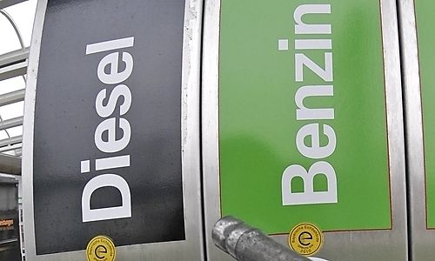
Introduction
Widespread
Ecomic
Ecologic

Slide 3
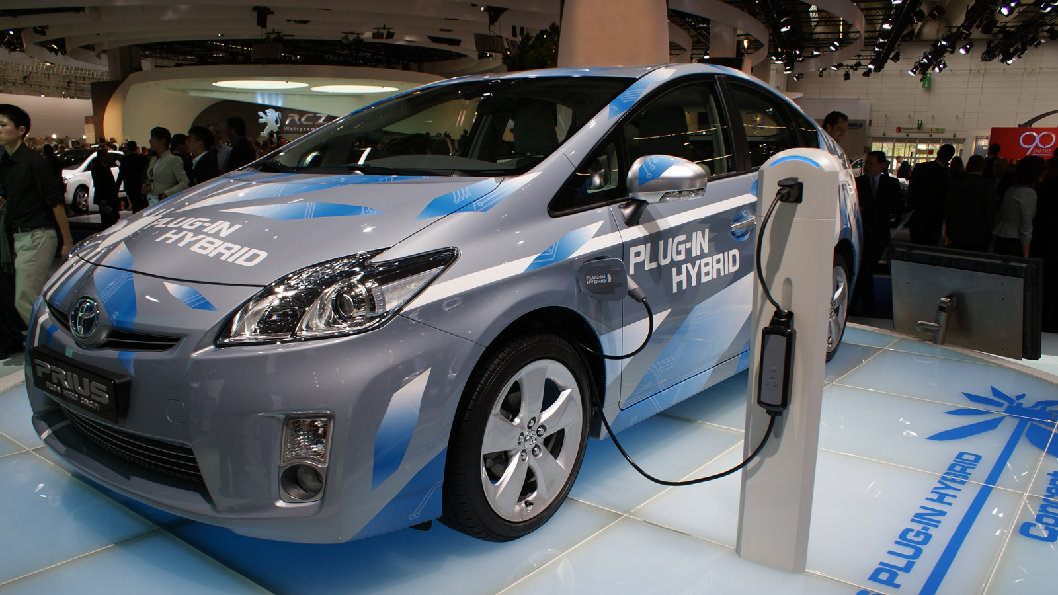
Introduction
increasingly in the market
mix of benzin engine and electric engine

Slide 4
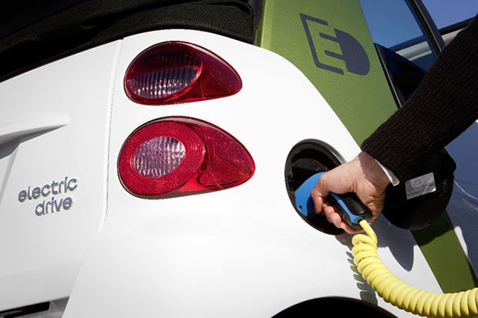
Introduction
few in number
more and more in our road

Slide 5
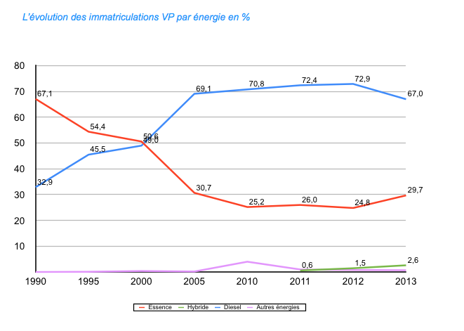
Evolution in the market
2000-2003 benzin
2010: hybrid
2011: electrical

Slide 6
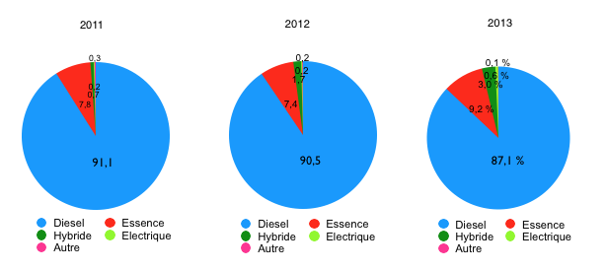
Evolution in the market
Diesel
Benzine
Hybrid
Electric

Slide 7
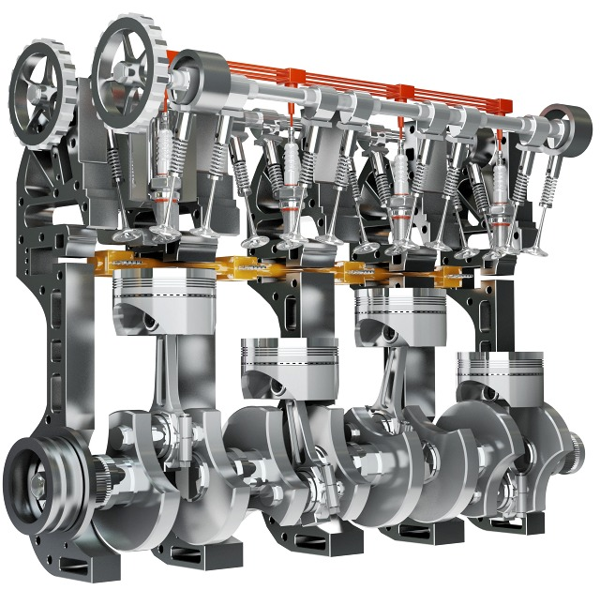
How benzine and diesel engine works
A fossil engine in a mechanical movment
Four stock
Cycle 720°

Slide 8
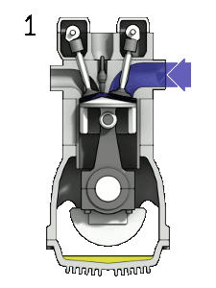
How benzine and diesel engine works
Benzine:
explosion engine
1: mix aire benzine
2: compression
3: exhaust off and explosion
4: propel dawn , reject brun gaz
,,,,

Slide 9
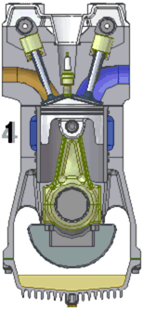
How benzine and diesel engine works
Diesel:
combustion engine
1: air
2: compression
3: exhaust in, introduction of diesel
4: propel dawn , reject brun gaz
,,,,

Slide 10
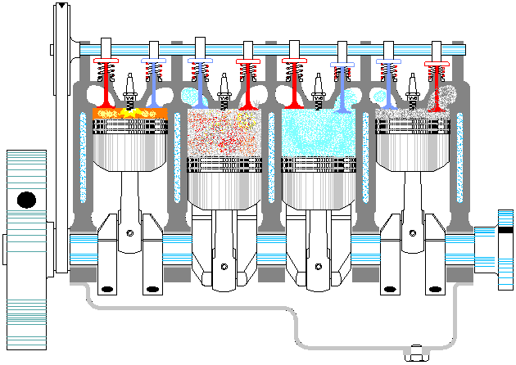
How benzine and diesel engine works
In our car

Slide 11

Difference between an engine diesel and benzine
explosion for the benzin and combustion for the diesel
benzine heating more quickly than the diese
benzine is more powerful
more vibration for the diesel, and more noise for the benzine.

Slide 12
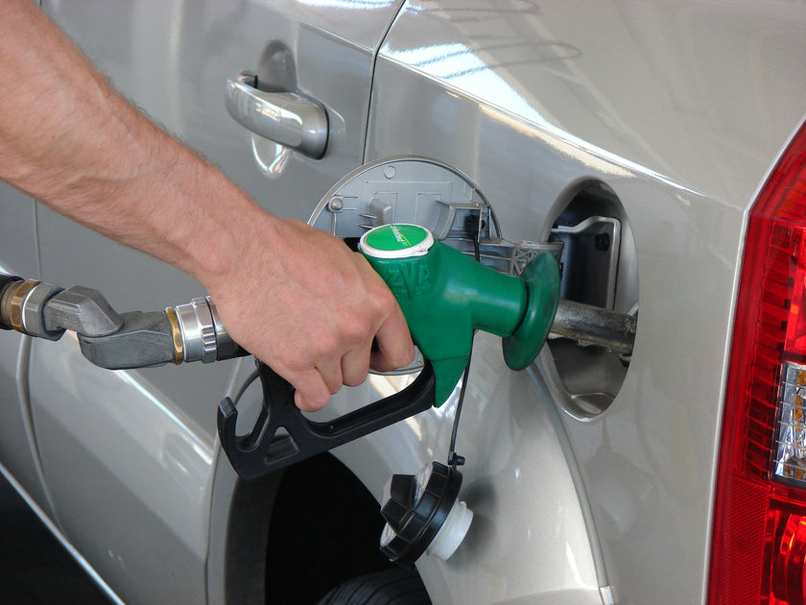
Advantage and inconvenient for the benzine
+ nervouse
+ maintenance more easy
- consume more than the diesel engine
- more noise

Slide 13
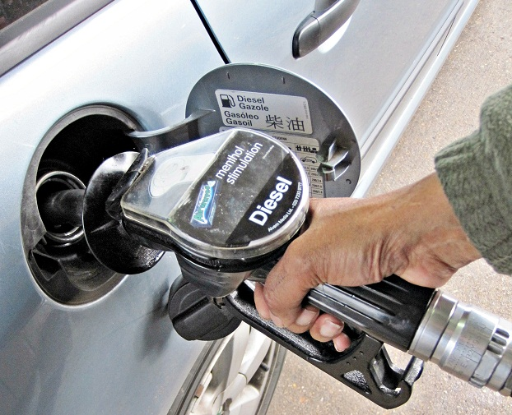
Advantage and inconvenient for the benzine
+ Economic +/-
+ Ecologies +/-
+ Less consume
- Vibration
- less couple

Slide 14
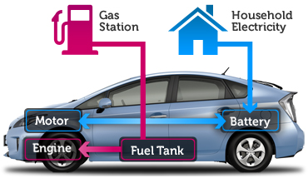
How hybrid work
combination of an eclectic engine and benzene engine
slowly with a low couple the engine electric run
need more power the diesel engine run

Slide 15
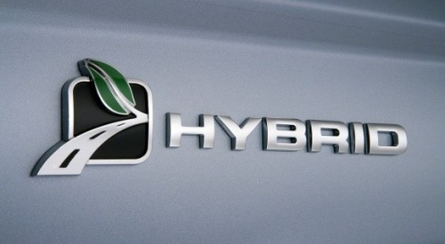
Why the hybrid
City drive low
Traffic Jam
Economi
Ecologi

Slide 16
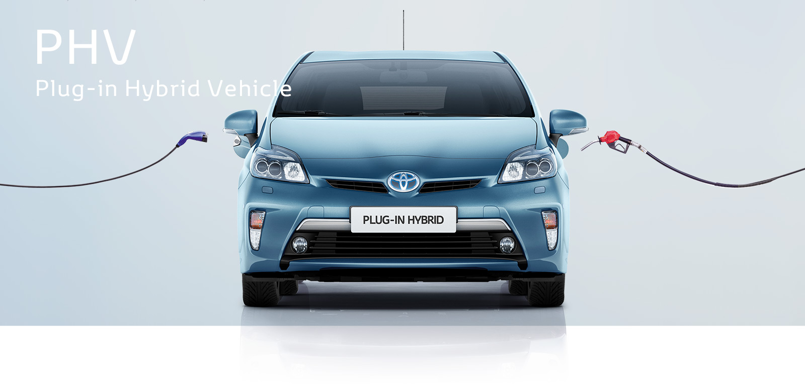
How it works
depending of the model
The battery is charging with the cars, and there are models need an extern charging (with a plug )
With the charging intern the systeme can charg by the braking or with a generator

Slide 17
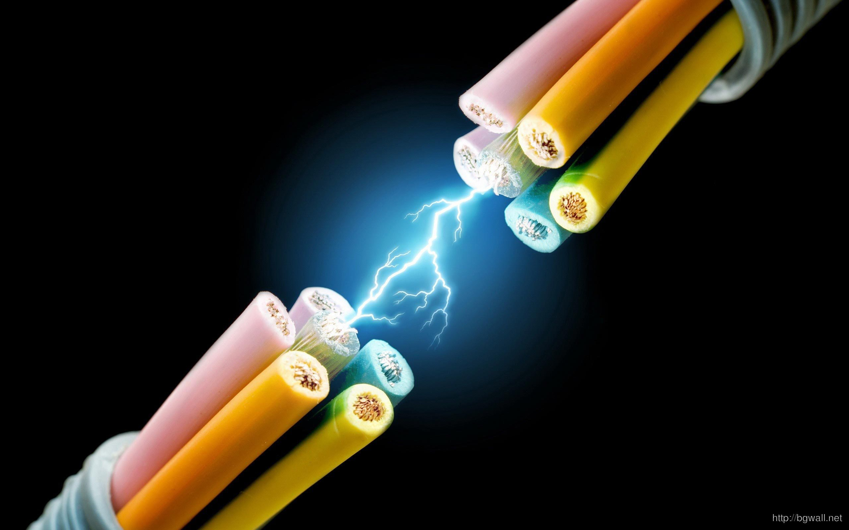
Inconveignant of the hybrid
Expensive
batery need hazardous materials (like the litium)
reparations is expensive
Autonomy short
Mountain

Slide 18
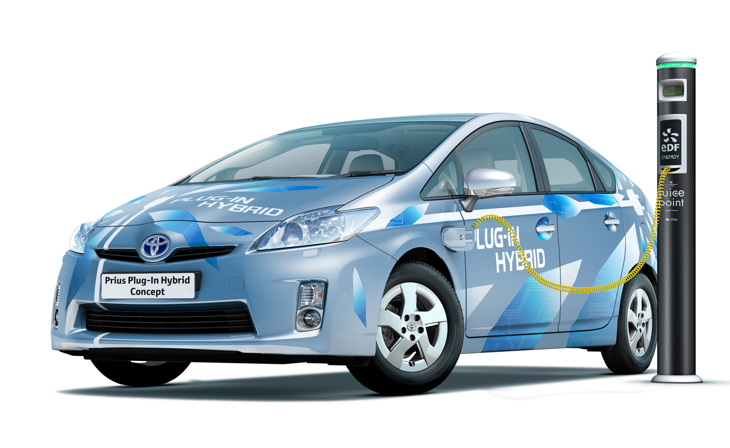
Avantage of the hybride
+- economic because the car is more expensif
+- ecologic
+ no noise and no vibration when the electic engine run
+ less tax

Slide 19

Electric

Slide 20
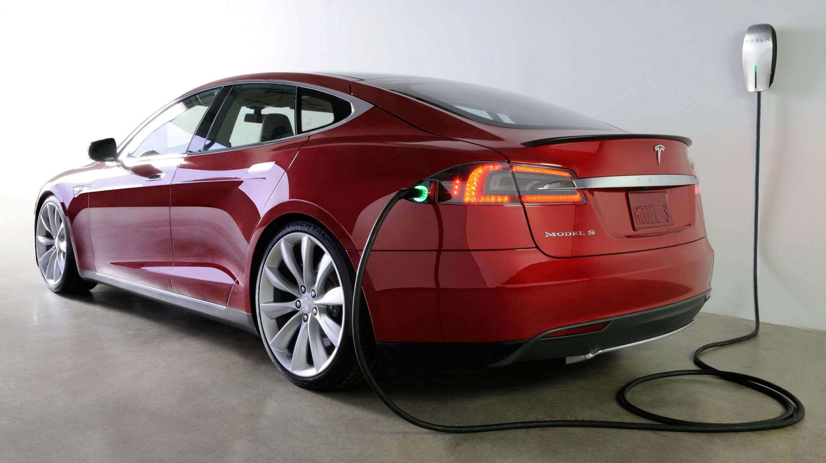
Why electric engine
No noise no vibration, the electricty is cheaper than the benzine, tax benefit.
My opinion there is no big reason to drive electric car.

Slide 21

Inconveignant of the electric
The autonomy of the battery,
need a plug for the car
the car is very expensive
the battery have hazardous material
a danger of electrocuter,
not profitable,
the extrem temperateur can make a problemes for the batery of the car.

Slide 22
Quizz
Les f1 fonctionnement avec quelle type de d’energie ?
Un moteur bruillant est un moteur ?
A puissance egale quelle est le meilleur couple entre un diesel et un essence ?
Quelle vehicule succite le plus de depense en cas de probleme
Pour quelle raison un moteur a combusion a besoin d’une bougie ?

Slide 23
Conclusion
Its depend of the user of his budget, of his idealogie
Certaine personne ne consoivent pas conduire a l’essence ni au diesel pour l’envornement, bien que la rentabilité ne pas au rdv et que les batterie pollue elle aussi.
Dautre personne cherche les sensation de la conduite et l’essence peux les satisfaire
Le diesel est moin cher que l’essence mais les voiture diesel sont plus cher que l’essence si un personne utilise tres peux sa voiture, choisir le diesel pour motive economique n’a pas de sense ,
l’ hybride peux consilier les 2 point de vus surtout que les prix se democrtise aussi.

Slide 24
Video
https://www.youtube.com/watch?v=-9kgvIIcKTc

